Slide 1
The Efficiency of Algorithms
Chapter 4
Data Structures and Abstractions with Java, 4e
Frank Carrano
© 2015 Pearson Education, Inc., Upper Saddle River, NJ. All rights reserved.

Slide 2
Why Efficient Code?
Computers are faster, have larger memories
  So why worry about efficient code?
And … how do we measure efficiency?
© 2015 Pearson Education, Inc., Upper Saddle River, NJ. All rights reserved.

Slide 3
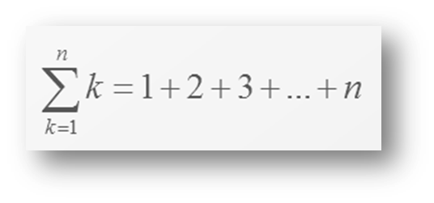
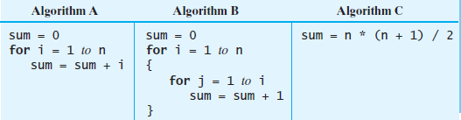
Example
Consider the problem of summing
FIGURE 4-1 Three algorithms for computing the sum
1 + 2 + . . . + n for an integer n > 0
© 2015 Pearson Education, Inc., Upper Saddle River, NJ. All rights reserved.

Slide 4
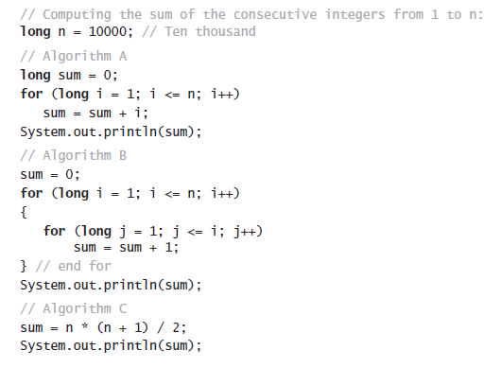
Example
Java code for the three algorithms
© 2015 Pearson Education, Inc., Upper Saddle River, NJ. All rights reserved.

Slide 5
What is “best”?
An algorithm has both time and space constraints – that is complexity
  Time complexity
  Space complexity
This study is called analysis of algorithms
© 2015 Pearson Education, Inc., Upper Saddle River, NJ. All rights reserved.

Slide 6
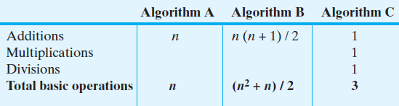
Counting Basic Operations
A basic operation of an algorithm
  The most significant contributor to its total time requirement
FIGURE 4-2 The number of basic operations
required by the algorithms in Figure 4-1
© 2015 Pearson Education, Inc., Upper Saddle River, NJ. All rights reserved.

Slide 7
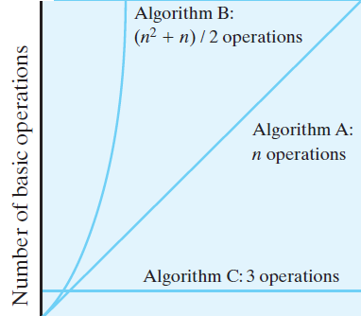
Counting Basic Operations
FIGURE 4-3 The number of basic operations required by the algorithms in Figure 4-1 as a function of n
© 2015 Pearson Education, Inc., Upper Saddle River, NJ. All rights reserved.

Slide 8
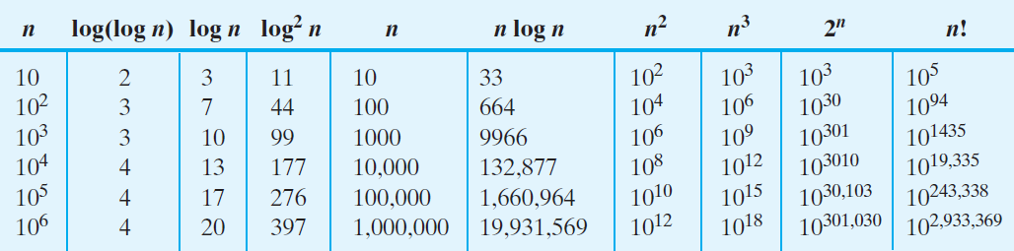
Counting Basic Operations
FIGURE 4-4 Typical growth-rate functions evaluated
at increasing values of n
© 2015 Pearson Education, Inc., Upper Saddle River, NJ. All rights reserved.

Slide 9
Best, Worst, and Average Cases
For some algorithms, execution time depends only on size of data set
Other algorithms depend on the nature of the data itself
  Here we seek to know best case, worst case, average case
© 2015 Pearson Education, Inc., Upper Saddle River, NJ. All rights reserved.

Slide 10
Big Oh Notation
A function f(n) is of order at most g(n)
That is, f(n) is O(g(n))—if
  A positive real number c and positive integer N exist …
  Such that f(n) ≤ c x g(n) for all n ≥ N
  That is, c x g(n) is an upper bound on f(n) when n is sufficiently large
© 2015 Pearson Education, Inc., Upper Saddle River, NJ. All rights reserved.

Slide 11
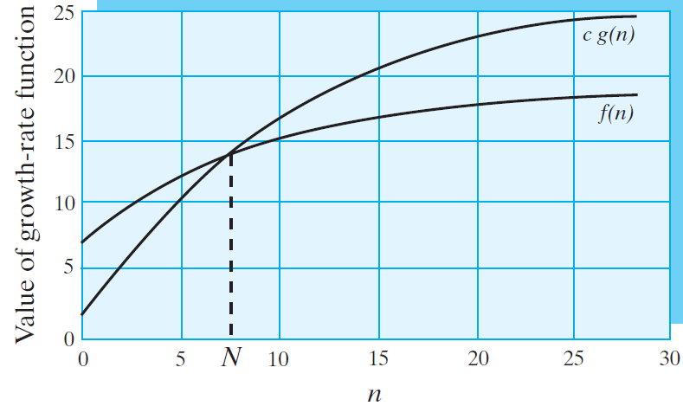
Big Oh Notation
FIGURE 4-5 An illustration of the definition of Big Oh
© 2015 Pearson Education, Inc., Upper Saddle River, NJ. All rights reserved.

Slide 12
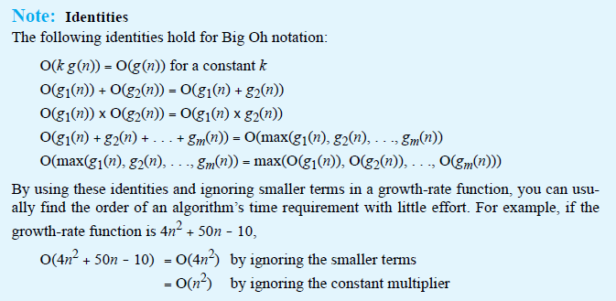
Big Oh Notation
Identities for Big Oh Notation
© 2015 Pearson Education, Inc., Upper Saddle River, NJ. All rights reserved.

Slide 13
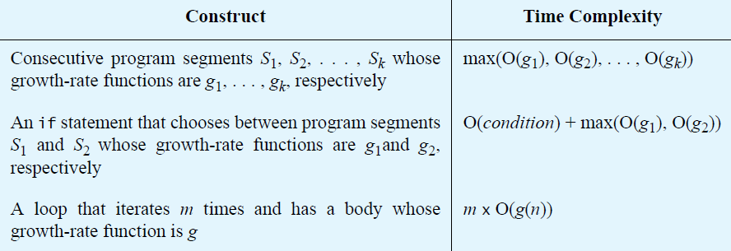
Complexities of Program Constructs
© 2015 Pearson Education, Inc., Upper Saddle River, NJ. All rights reserved.

Slide 14
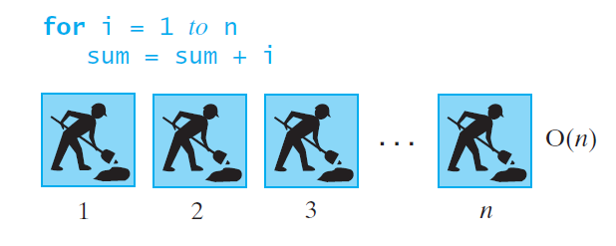
Picturing Efficiency
FIGURE 4-6 An O(n) algorithm
© 2015 Pearson Education, Inc., Upper Saddle River, NJ. All rights reserved.

Slide 15
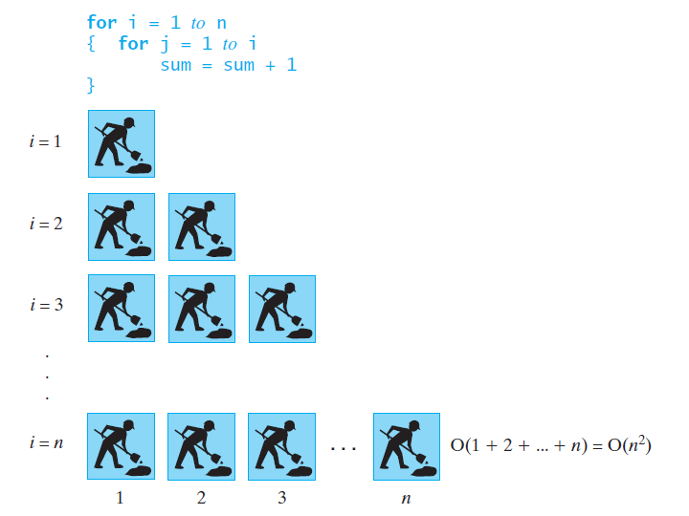
Picturing Efficiency
FIGURE 4-7 An O(n²) algorithm
© 2015 Pearson Education, Inc., Upper Saddle River, NJ. All rights reserved.

Slide 16
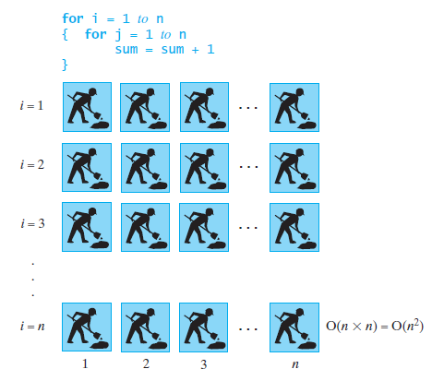
Picturing Efficiency
FIGURE 4-8 Another O(n²) algorithm
© 2015 Pearson Education, Inc., Upper Saddle River, NJ. All rights reserved.

Slide 17
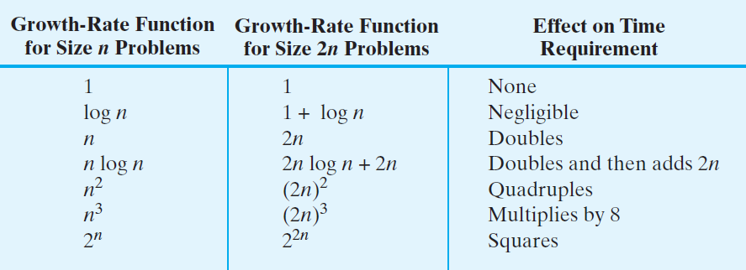
Picturing Efficiency
FIGURE 4-9 The effect of doubling the problem
size on an algorithm’s time requirement
© 2015 Pearson Education, Inc., Upper Saddle River, NJ. All rights reserved.

Slide 18
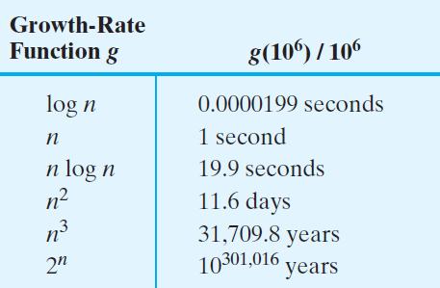
Picturing Efficiency
FIGURE 4-10 The time required to process one million items by algorithms of various orders at the rate of one million operations per second
© 2015 Pearson Education, Inc., Upper Saddle River, NJ. All rights reserved.

Slide 19
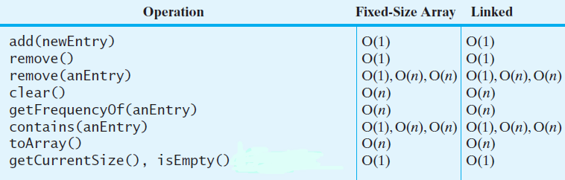
Efficiency of
Implementations of ADT Bag
FIGURE 4-11 The time efficiencies of the ADT bag operations for two implementations, |
expressed in Big Oh notation
© 2015 Pearson Education, Inc., Upper Saddle River, NJ. All rights reserved.

Slide 20
End
Chapter 4
© 2015 Pearson Education, Inc., Upper Saddle River, NJ. All rights reserved.

